Slide 1
Chapter 4: Threads

Slide 2

Single and Multithreaded Processes
Thread, sometimes called lightweight process (LWP), is a basic unit of CPU utilization
  Consists of a thread ID, program counter, a register set, and a stack
  Share with other threads belonging to the same process its code section, data section, and other operating system resources such as open files

Slide 3
Benefits
Responsiveness
  Multithreading a interactive application may allow a program to continue running even if part of it is blocked or is performing a lengthy operation
Resource Sharing
  Code and data sharing among threads allows an application to have several different threads of activity all within the same address space
Economy
  More economical to create and context switch threads because of resource sharing
Utilization of Multiprocessor Architectures
  Each thread may be running on a different processor
An example:
  A busy web server that has multiple clients concurrently accessing it
  One thread listens for client requests and creates a thread to handle the request from each client

Slide 4

Multithreaded Server Architecture

Slide 5
Process vs. Thread?
Difference
  Process
    Heavy weight process
    Don’t share code section, data section, and other operating system resources such as open files
  Thread
    Light weight process
    Consists of a thread ID, program counter, a register set, and a stack
    Share with other threads belonging to the same process its code section, data section, and other operating system resources such as open files
Relationship
  One process may have one or multiple threads.
  Each thread must belong to a process

Slide 6
User Threads
Thread management done by user-level threads library
  User-level thread library provides support for thread creation, scheduling, and management
  Generally fast to create and manage; however, if the kernel is single-threaded, any blocked user-level thread will cause the entire process to block
Three primary thread libraries:
  POSIX Pthreads
  Win32 threads
  Java threads

Slide 7
Kernel Threads
Supported by the Kernel
  Generally slower to create and manage than user threads;
Examples
  Windows 7, XP/2000
  Solaris
  Linux
  Mac OS X
  …….

Slide 8
Multithreading Models
Many-to-One
One-to-One
Many-to-Many

Slide 9
Many-to-One
Many user-level threads mapped to single kernel thread
Thread management is done by the thread library in user space, so it is efficient
The entire process will block if a thread of the process is blocked
Examples:
  Solaris Green Threads
  GNU Portable Threads

Slide 10
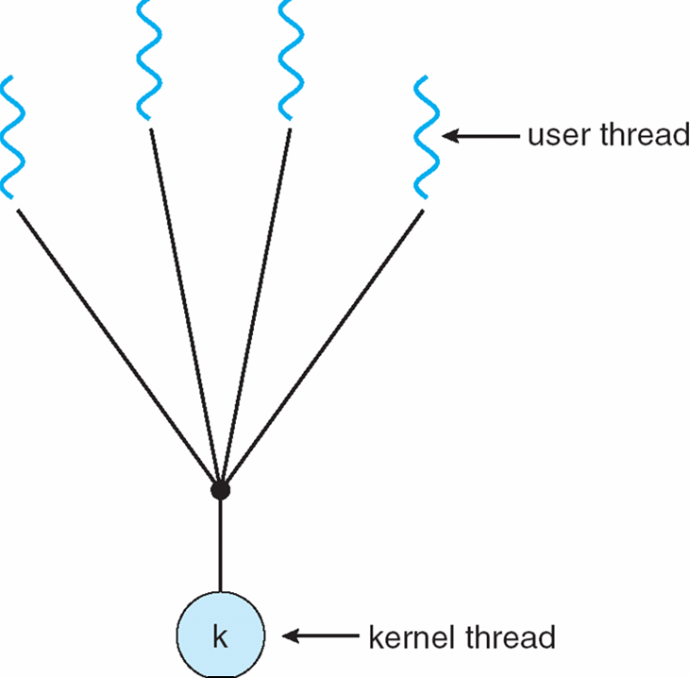
Many-to-One Model

Slide 11
One-to-One
Each user-level thread maps to a kernel thread
  Provides more concurrency
  Creation of kernel thread causes overhead, most implementation of this model restrict the number of threads supported by the system
Examples
  Windows 7, NT/XP/2000
  Linux
  Solaris 9 and later

Slide 12
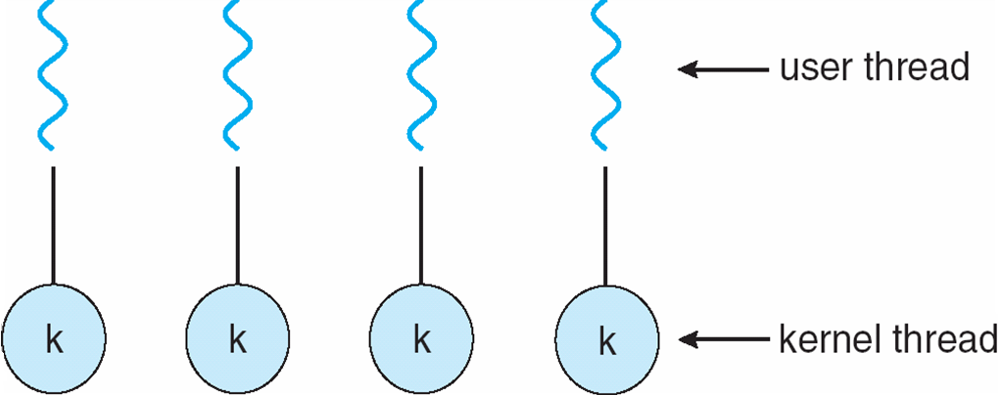
One-to-one Model

Slide 13
Many-to-Many Model
Multiplexes many user level threads to a smaller or equal number of kernel threads.
Allows users create as many user threads as necessary, and the corresponding kernel threads can run in parallel on a multiprocessor
Solaris prior to version 9

Slide 14

Many-to-Many Model

Slide 15
Thread Libraries
Thread library provides programmer with API for creating and managing threads
Two primary ways of implementing
  Library entirely in user space
  Kernel-level library supported by the OS

Slide 16
Pthreads
a POSIX standard (IEEE 1003.1c) API for thread creation and synchronization.
API specifies behavior of the thread library, implementation is up to development of the library.
Pthread programs must include the pthread.h header file
A separate thread is created with the pthread_create function
The name of the function where the new thread will begin execution is passed to pthread_create as a parameter
The main thread wait for the new thread to complete by calling the pthread_join function
Example program
  Figure 4.6 on page 133

Slide 17
Win32 Threads
CreateThread to create a thread
Example program
  Figure 4.7 on page 135

Slide 18
End of Chapter 4

